Slide 1
Mongo DB

Slide 2
Introduction to RDBMS
Features of RDBMS/Advantages:
stores data in tables in a structured form, hence significantly reduces iteration time.
data persists in the form of rows and columns.
primary key to define unique identification of rows.
creates indexes for quicker data retrieval.
Disadvantages:
Cost of setup is high.
Static schema.
Limited to storage (database sizes).
Confusing to categorize complex data (files, images, audio etc.)
Deals with only structured data, does not deal with semi-structured and unstructured data.
Scalability.

Slide 3
Introduction to NoSQL
NoSQL means Not only SQL, we are not going to use SQL
NoSQL is Non-relational database management system
Why NoSQL?
Huge amount of data → Big Data (unstructured, semi-structured, Structured)
RDBMS is mainly designed for structured data. But from the social networking sites, ecommerce sites, we are generating huge amount of unstructured data which is not supported by RDBMS and gives the origin of Big Data.

Slide 4
Features of NoSQL Databases
Stores large volume of structured, semi-structured and unstructured data
High performance, high scalability and high availability
Quick iteration
Supported by Object Oriented Programming that is easy to use and flexible
Dynamic schemas
Auto-sharding
Replication

Slide 5
Types of NoSQL Databases
There are four types of NoSQL Databases.
Key- value stores : Redis, Dynamo, Riak [stores data in key-value pair]
Column-oriented : BigTable, Cassandra, SimpleDB [stores data in columnar fashion]
Graph : OrientDB, Neo4J, Titan [stores data in graphical manner]
Document-oriented : MongoDB, CouchDB [stores data in the form of document (JSON)]

Slide 6
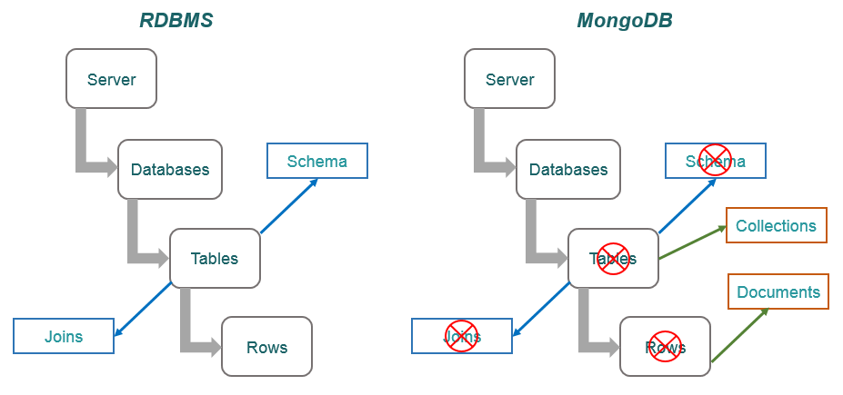
Difference Between RDBMS & MongoDB

Slide 7
Basics of MongoDB
Creating new database: use database_name
‘use tempdb’ command will create a database, named tempdb. After executing the command you will get the following message: “switched to db tempdb”, that means db will start pointing to tempdb database where ‘db’ holds the current reference. If the database already exits then it will only switch to that, will not create a new.
Creating a collection (Table in RDBMS): db.collection_name
‘db.tempCollection’ will create a collection, named tempCollection
Inserting data into collection: db.collection_name.insert(JSON_Data)
‘db.tempCollection.insert({name: "mongodb", category: "nosql", tags: ["nosql", "db", "bigdata"]})’ will insert the specified JSON data into tempCollection.
On successful insertion you will get the following message: “WriteResult({ "nInserted" : 1 })”

Slide 8
Basics of MongoDB
Retrieving data from collection: db.collection_name.find()
db.tempCollection.find() will return all the documents from the specified collection along with the mongodb created object Id.
{ "_id" : ObjectId("5b1c22983be2d66c8733cc78"), "name" : "mongodb", "category" :
"nosql", "tags" : [ "nosql", "db", "bigdata" ] }

Slide 9
Basics of MongoDB
Retrieving data from collection in formatted way: db.collection_name.find().pretty()
db.tempCollection.find().pretty() will return all the documents in formatted way.
{
"_id" : ObjectId("5b1c22983be2d66c8733cc78"),
"name" : "mongodb",
"category" : "nosql",
"tags" : [
"nosql",
"db",
"bigdata"
]
}

Slide 10
Basics of MongoDB
Create and save a document in a collection: db.collection_name.save(document)
var doc = {};
doc.name = “John”;
doc.age = 28;
doc.tags = [“database”, “NoSQL”, “DBA”, “Dev”];
doc.createdOn = new Date();
db.tempCollection.save(doc)
show collections displays the collection present in a database

Slide 11
Basics of MongoDB
Display all the Databases: show dbs
Dropping a Database: First you need to switch to that database (using use database_name) which you want to drop/delete. Then execute the following command: db.dropDatabase()
Creating collection with createCollection method :
Signature: db.createCollection(database_name, options_document)
First parameter is a String, which is the name of the database and second parameter is a document (JSON), which specifies the configuration (capped, autoIndexID, size, max).
‘capped: true’ will create capped collection, which means it will delete oldest entries when it will reach to it’s maximum size.
For ‘capped: true’ you need to specify the size field (in bytes) as well.
‘autoIndexID: true’ creates underscored Id, by default it is false.
If you want to restrict the collection in terms of number of documents, then specify the max field.

Slide 12
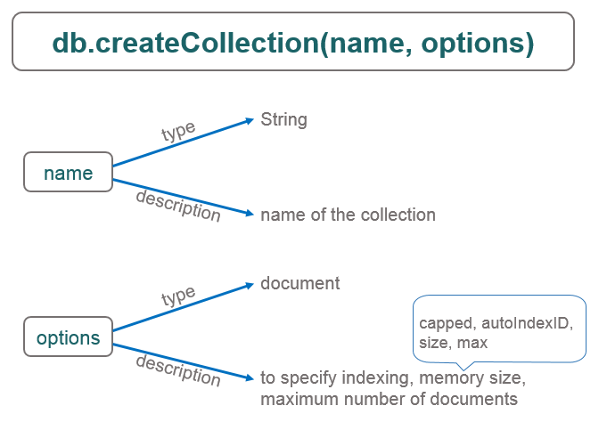
Basics of MongoDB

Slide 13
Basics of MongoDB
db.createCollection(“articles”) will create articles collection. Here we are not specifying optional parameter.
Now execute show collections to verify whether the collection has been created or not.
db.createCollection("blogs", {capped: true, size: 367900, max: 500})
Dropping a collection: First switch to database and then check for the collections using show collections command.
db.collection_name.drop()
db. blogs.drop() will drop the collection blogs.

Slide 14
MongoDB CRUD Operation
Creating/Inserting a document in collection using javascript file
Step 1: Create a javascript file with and save with a name studentsInfo.js and then paste the below code in it :
db.studentInfo.insert(
{
name:{firstName:"John", lastName:"Doe"},
class:6,
rollNo: 23,
subjects:["Maths","Physics","English","Chemistry"],
attendance: {
January: "90%",
February:"85%",
March:"98%"
}
}
);

Slide 15
MongoDB CRUD Operation
db.studentInfo.insert(
{
name:{firstName:"Sunil", lastName:"Gupta"},
rollNo: 24,
subjects:["Maths","Physics","English","Chemistry"],
attendance: {
January: "97%%",
February:"99%",
March:"100%"
}
}
);

Slide 16
MongoDB CRUD Operation
db.studentInfo.insert(
{
name:{firstName:"Jonny", lastName:"Jon"},
rollNo: 27,
subjects:["Maths","Physics","English","Chemistry"],
attendance: {
January: "87%%",
February:"99%",
March:"100%"
}
}
);

Slide 17
MongoDB CRUD Operation
Step 2: And after saving the file. Load it in mongo shell with the below command:
> load(“e:/studentsInfo.js"); //if everything works well it will return true.
Step 3: Check the result with the below commands:
show collections;
// this will list all the collections in database including the newly created studentInfo
db.studentInfo.find().pretty();
//this will be returning all the documents inserted into the above collection.
Similarly, you can create an array of documents and insert that array using the following command:
Insert command: db.studentsInfoCollection.insert(studentsInfoArray); at the end of .js file
> load(“e:/studentsInfoArray.js");
*** The load(pathOfTheFile) loads a .js file containing mongodb commands and documents for bulk operations.

Slide 18
MongoDB CRUD Operation
Reading Data / Querying :
db.studentInfo.find().pretty() -- Returns all the documents in formatted way
db.studentInfo.find().[0] -- Returns the first document where ‘0’ represents the document index
db.studentInfo.find().[0].key -- Returns the value associated with the mentioned key
db.studentInfo.find().[0]._id -- Returns the object Id
db.studentInfo.find({“name.firstName” : “John”}).pretty() -- Returns the document(s) whose first name is John in formatted way. You can write multiple parameters in the query object.
db.studentInfo.find({“rollNo” : 27}).pretty()
db.studentInfo.find({“rollNo” : {$eq:27}}).pretty() – same as above. $eq is ‘equivalent’ operator
db.studentInfo.find({“name.firstName” : {$eq: “John”}}).pretty()
db.studentInfo.find({“rollNo” : {$lt:25}}).pretty() – same as above. $lt is ‘less than’ operator
db.studentInfo.find({“rollNo” : {$gt:25}}).pretty() – same as above. $gt is ‘greater than’ operator

Slide 19
MongoDB CRUD Operation
Other Operators:
$lte is ‘less than or equals’ to operator
db.studentInfo.find({“rollNo” : {$lte:25}}).pretty()
$gte is ‘greater than or equals’ to operator
db.studentInfo.find({“rollNo” : {$gte:25}} ).pretty()
$ne is ‘not equal to’ operator. Returns all the documents except the mentioned value.
db.studentInfo.find({“rollNo” : {$ne:25}} ).pretty()
$in is ‘in’ operator. Takes an array and checks for those values defined in the array.
db.studentInfo.find( {“rollNo” : {$in:[25, 27, 29]}} ).pretty()
$nin is ‘not in’ operator. Takes an array and skips those values defined in the array.
db.studentInfo.find({“rollNo” : {$nin:[25, 27, 29]}} ).pretty()
$exists is ‘exists ’ operator. Checks for existence for a field and if exits then go for other operators
db.studentInfo.find({“rollNo” : {$exists: true, $nin:[25, 27, 29]}}).pretty()

Slide 20
MongoDB CRUD Operation
Updating Document:
db.collection_name.update(condition, field_needs_to_be_updated)
db.studentInfo.update({“name.firstName” : “Sunil”}, {$set : {“rollNo” : 30}})
db.collection_name.update(condition, field_needs_to_be_updated, condition_of_new_creation)
db.studentInfo.update({“name.firstName” : “Sunil”}, {$set : {“rollNo” : 30}}, {upsert: true})
Here ‘upsert: true’ means, if it finds the match then it will update the document, otherwise it will create a new document. ‘upsert: false’ will do neither.
db.collection_name.update(condition, field_needs_to_be_updated)
db.studentInfo.update({“name.firstName” : “Sunil”}, {$set : {“subjects.1” : “Biology”}})
Here ‘subjects’ is an array and ‘subjects.1’ indicates the second field which will be updated here.

Slide 21
MongoDB CRUD Operation
Deleting Document:
db.collection_name.remove({}) -- removes all the documents.
db.studentInfo.remove({})
db.collection_name.remove(condition) -- removes all the documents that match the condition
db.studentInfo.remove({“name.firstName” : “Sunil”})
db.collection_name.remove(condition) -- removes all the documents that matches the condition (array). Here subjects is an array.
db.studentInfo.remove({“subjects” : “Maths”})
db.collection_name.remove(condition, wants_to_remove_first_one) – removes the first document which matches the condition.
db.studentInfo.remove({“subjects” : “Maths”}, 1/true)

Slide 22
Performance Tuning with Indexes
Creating an Index with createIndex method:
db.collection_name.createIndex({field_name: 1/-1})
Here 1 means ascending order and -1 means descending order.
db.studentInfo.createIndex({“rollNo”:1})
Now execute the search query as db.studentInfo.find( {“name.firstName” : “John”}).pretty()
Finding the Index(s) getIndexes using method:
db.collection_name.getIndexes()
db.studentInfo.getIndexes() – return all the indexes for the specified collection.
Dropping an Index with dropIndex method:
db.collection_name.dropIndex({index_field_name: 1/-1})
db.studentInfo.dropIndex({“rollNo”:1})

Slide 23
ObjectId in MongoDB
Mongo DB internally by default creates an object Id for every document which is similar to primary key in RDBMS. This object Id, created by Mongo DB, is a combination of host name, date and time, process Id (PID) and some incrementing number. It is Immutable, Unique, BSON datatype, 12 bytes value.
You can also override this object Id by providing ‘_id: id_value’ in your document as follows:
db.collection_name.insert({“_id”: 001, “name”: John})
Advantages:
You retrieve the details of date-time, host name, process Id etc. from the mongoDB created object Id.
db.collection_name.find()[0]._id.getTimestamp() -- returns the timestamp (in ISO format)
Disadvantages:
If you are creating your own object Id, then You will not be able to retrieve the above mentioned details.
The object Id is hard to remember because of it’s complexity and not very useful at the time of querying through URL (bookshop/booktype/bookID[objectId])

Slide 24
Aggregation Framework
What is Aggregation?
Process date records (documents) and return results
Group values from various documents in collection together
Performs various operations on the grouped data
In RDBMS count(*) and group by are equivalent of mongo db aggregation.
Aggregation method:
aggregate() method is used to perform aggregation on collection in mongo db. It takes ‘operation to be performed’ as parameter.
Parameters: $sum, $avg, $min, $max, $first, $last, $group
db.collection_name.aggregate(paramter)

Slide 25
Aggregation Framework
db.studentInfo.aggregate({$group: {_id: "$name.firstName", total: {$sum:1}}})
The above will result name as _id and total number of documents present with that name.
Distinct method:
distinct(parameter/condition) method returns the distinct values for the given parameter.
db.studentInfo.distinct("name.firstName")
db.studentInfo.distinct(“subjects")
Count method:
count() method returns the total number of documents. It can also be used with find() method.
db.studentInfo.count()
db.studentInfo.find({"name.firstName": "Jonny"}).count()

Slide 26
Aggregation Framework
Sort method:
sort(sorting_condition) method can be used to sort the documents depending upon the given sorting condition. This method is used along with the find() method and the sorting_condition is a JSON object.
db.studentInfo.find().sort({"rollNo":1}).pretty() – Documents will be sorted based on roll no in ascending order (1 represents ascending order here)
db.studentInfo.find().sort({"name.firstName":-1}).pretty() – Documents will be sorted based on first name in descending order (-1 represents descending order here)
db.studentInfo.find().sort({$natural:1}).pretty() – Documents will be sorted in natural order

Slide 27
Data Modeling
Key of Data Modeling:
Structure of Documents
Relationship between data
Tools to represent relationship:
References ( Refers to other document in a collection. Concept of primary key and foreign key in RDBMS)
Embedded Data (Document inside another document)

Slide 28
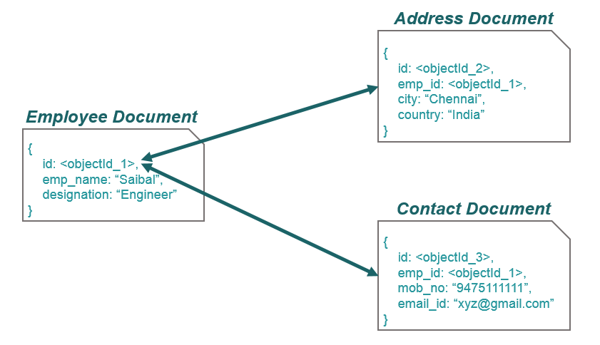
Data Modeling
Data Modeling using References:

Slide 29
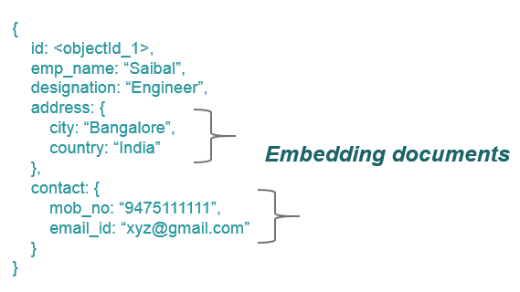
Data Modeling
Data Modeling using Embedded Document:

Slide 30
Relationship in MongoDB
One-To-One (1:1) Relationship
One-To-Many (1:N) Relationship
Many-To-Many (M:N) Relationship
In Mongo DB, relationship can be achieved using Referencing and Embedding documents.

Slide 31
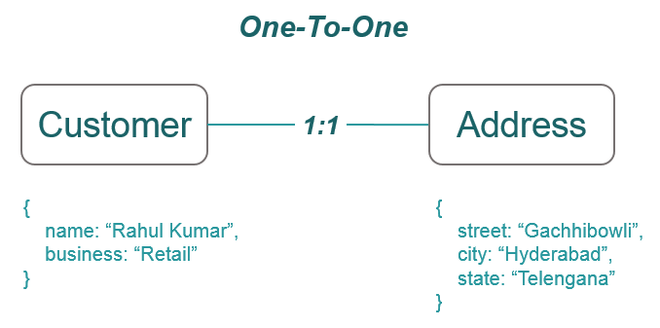
Relationship in MongoDB
One-To-One (1:1) Relationship:
In RDBMS, we can map one table to another table using the foreign key.

Slide 32
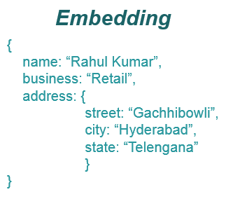
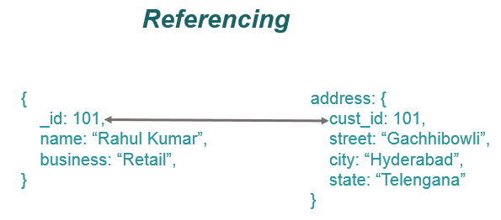
Relationship in MongoDB
One-To-One (1:1) Relationship:

Slide 33
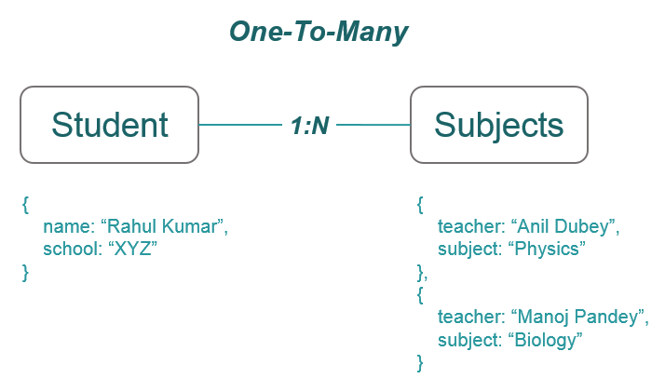
Relationship in MongoDB
One-To-Many (1:N) Relationship:

Slide 34
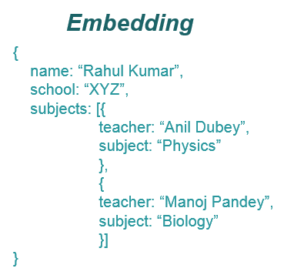
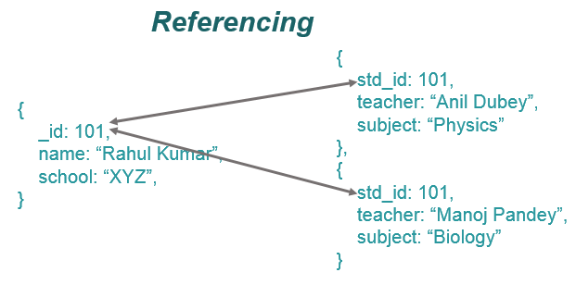
Relationship in MongoDB
One-To-Many (1:N) Relationship:

Slide 35

Relationship in MongoDB
Many-To-Many (M:N) Relationship:
In RDBMS, we can achieve this relationship using Joins and two-way foreign key.

Slide 36
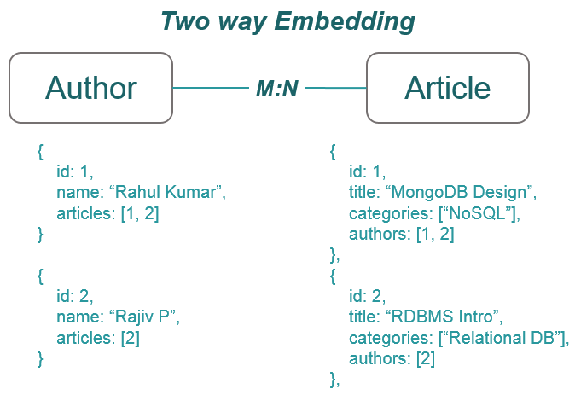
Relationship in MongoDB
Many-To-Many (M:N) Relationship:

Slide 37
User Role Management
db.getUsers() -- Returns all the users.
Creating User:
db.createUser({user: userName, pwd: password, roles: [{role: userRole, db: databaseName}]})
db.createUser({user: "john", pwd: "john", roles: [{role: "userAdmin", db: "tempdb"}]})
You can verify it by executing db.getUser() command.
Starting MongoDB server with Authentication:
You can start mongoDB server with authentication or with out authentication. Till now, we have started the server with out authentication.
Without Authentication: mongod --config C:\mongodb\mongo.config --journal
With Authentication: mongod --auth --config C:\mongodb\mongo.config –journal

Slide 38
User Role Management
After starting the server in authentication mode, if you execute show dbs command on mongo shell you will get an error message instead of getting the list of the databases.
"errmsg" : "not authorized on admin to execute command { listDatabases:1.0, $db: \"admin\" }",
"code" : 13,
"codeName" : "Unauthorized“
Now to access the databases you need to authorize yourself before you execute any command.
Connecting to Database with Authentication Details:
First switch to the database you want to access using use database_name command and then execute the following method on db reference by providing the credentials to authenticate yourself.
db.auth(username, password)
db.auth(“john”, “john”) -- Upon successful authentication you will see 1 on the console.

Slide 39
Regular Expression in MongoDB
Regular expression is used to match pattern in a strings.
Regular expression is used to search for a pattern or word in any string.
Regular Expression Operator:
$regex: operator
db.collection_name.find({key : {$regex: value}})
db.studentInfo.find({“name.firstName” : {$regex: “John”}}).pretty()
Alternate way to write regular expression without $regex operator
db.studentInfo.find({“name.firstName” : /John/}).pretty()
Name starts with ‘S’ : db.studentInfo.find({“name.firstName” : /^S/}).pretty()
Name ends with ‘n’ : db.studentInfo.find({“name.firstName” : /n$/}).pretty()

Slide 40
Regular Expression in MongoDB
Matching with case insensitive:
$options: value
db.collection_name.find({key : {$regex: value, $options: ‘i’ }})
Here ‘i’ means insensitive. There are more values that we can pass to this option operator.
Name ends with ‘n’ or ‘N’ :
db.studentInfo.find({“name.firstName” : {$regex: /N$/, $options: ‘i’}).pretty()

Slide 41
Map Reduce in MongoDB
It is one of the popular feature of mongo db.
What is map-reduce?
Map-reduce is a data processing paradigm for condensing large volumes of data into useful aggregated results.
There are two functions, mapper and reducer.
For map-reduce operations, MongoDB provides the mapReduce database command.
db.collection_name.mapReduce(mapperFunction(){}, reducerFunction(){})
db.loadDetails.mapReduce(
[mapper] function() {emit( this.emp_id, this.loanAmount);}),
[reducer] function(key, values) {return Array.sum(values)},
{
[query] query: {loanStatus: “Active”},
[out] out: “TotalLoan”
}
)

Slide 42
Map Reduce in MongoDB
db.loadDetails.mapReduce(
function() {emit(this.emp_id, this.loanAmount);}),
function(key, values) {return Array.sum(values)},
{
query: {loanStatus: “Active”},
out: “TotalLoan”
sort: document
limit: number
}
)
After executing the above command, you can get the output document as ‘TotalLoan’ which is mentioned for the ‘out’ key. db.TotalLoan.find().pretty() will display the result.
You can directly get the result by appending find() function at the end of the command.

Slide 43
Replication in MongoDB
What is Replication?
In general, Replication means creating the same(identical) of anything.
Here in Mongo DB, We deals with data. So, we will be creating the replica of same data.
Replica(s) is/are also known as Secondary data (copy of primary data). Replicas are all together called as Replica Set (a set of replica data).
Why do we need Replication?
Basically the need of replication is to make the data available all the time.
Data Availability.
Load Balancing.
Disaster Recovery.
Reporting.
Backup.

Slide 44
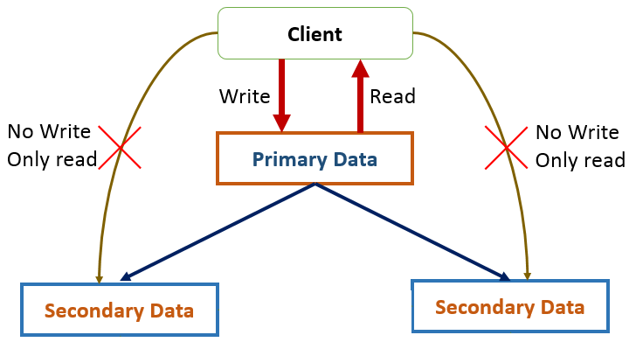
Replication in MongoDB
Replication Architecture:
Client has no access to perform write operation to secondary nodes (databases). Client can only perform write operation to primary node (database). The primary node maintains a log, from which the secondary nodes update themselves. The secondary nodes also communicate with each other through a process called Heartbeat.

Slide 45
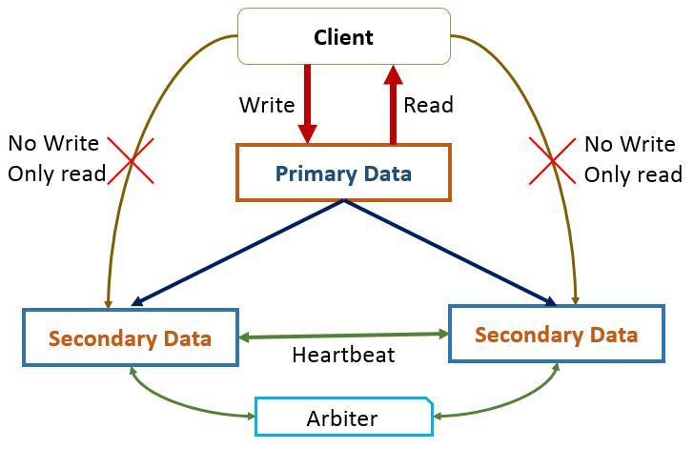
Replication in MongoDB
Understanding Heartbeat and Arbiter:
Heartbeat is a process of communication between two or more secondary nodes (secondary databases) to keep them alive and update.
Arbiter is a Mongo DB instance without any data or simply a data-node without any data. The purpose of keeping this node is to help selecting the secondary node among multiple nodes when the primary node is down. Arbiter also communicates with other nodes through heartbeat.

Slide 46
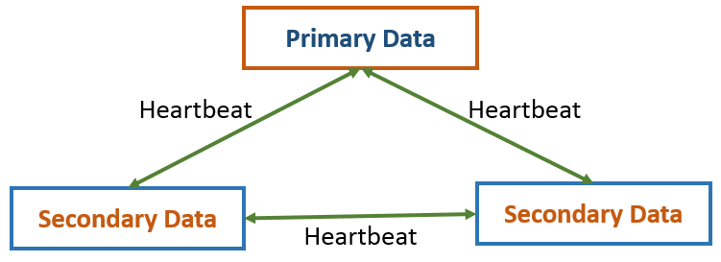
Replication in MongoDB
Since client cannot perform write operation when the primary node is down, mongo db needs to choose a primary node from the replica set. This process is know as election. At time of election Arbiter plays an important role if there is tie.
Factors for choosing Primary from the secondary nodes:
All the nodes (primary and secondary) communicate with each other through heartbeat. Each node sends heartbeat to other connected nodes in every 2 seconds and expect response in every 10 seconds. If it finds that the primary node is not responding on heartbeat then the secondary nodes go for election to become the primary node and the primary node becomes secondary node.

Slide 47
Replication in MongoDB
Setting Single Node Replica Set:
mongod --replSet replicaDB --dbpath C:\mongodb\data\db1
Here replSet is the mongo db command to start the server with replica set feature.
After starting the server, you will see the following message on the console.
{ replication: { replSet: "replicaDB" }, storage: { dbPath: "C:\mongodb\data\db1" } }
Now run the mongo shell and type the following command.
rs.status() – will return the status of replica set.
{
"info" : "run rs.initiate(...) if not yet done for the set",
"ok" : 0,
"errmsg" : "no replset config has been received",
"code" : 94,
"codeName" : "NotYetInitialized"
}
This means no primary node is selected till now.

Slide 48
Replication in MongoDB
To select the primary node run the following command.
rs.initiate() – will initiate the replica set and make your current node as primary node. you will the console prompt has been changed to replicaDB:PRIMARY
Now run rs.status() and you will be able to see the status of your current node (which is now primary)
Since we do not have multiple servers as we are using laptop, let us run multiple instances of the same server on different ports.

Slide 49
Replication in MongoDB
Setting Multi Node Replica Set:
Since we do not have multiple servers as we are using laptop, let us run multiple instances of the same server on different ports. So, we are going to run 3 instances and will make one of them as primary and to that we will be adding 2 instances as secondary.
Instance One:
mongod --replSet replicaDB --dbpath C:\mongodb\data\db [on default port]
mongo
Instance Two:
mongod --replSet replicaDB --dbpath C:\mongodb\data\db1 --port 27018 [on port 27018]
mongo --port 27018
Instance Three:
mongod --replSet replicaDB --dbpath C:\mongodb\data\db2 --port 27019 [on port 27019]
mongo --port 27019

Slide 50
Replication in MongoDB
After executing all the commands three instances will be started. Execute rs.status() command in each console to check whether there already a primary node or not. If there is no primary node then make one of them as primary node by executing rs.initiate() command and verify it with rs.status() command.
Now get the host name from the other two nodes (running instances) by executing db.hostInfo() command. Add the host names (of other running node instances) to the primary node by executing rs.add(host_name) command.
Example: (Assuming instance running on port default port is the primary node)
replicaDB:PRIMARY> rs.add("localhost:27018")
replicaDB:PRIMARY> rs.add("localhost:27019")
Now run rs.status() on any of the consoles and you will see Primary node (on default port), Secondary node (on port 27018) and Secondary node (on port 27019)

Slide 51
Sharding in MongoDB
What is Sharding?
Sharding is a method for distributing data across multiple machines.
To support deployment with very large data sets and with very high throughput.
Suppose we have a data set deployed into a single server. Now data set is increasing in size day by day, so we will have to increase the server capacity. It can be done by adding more RAM, HDD, CPU capacity etc. But it is very much costly. This is known as vertical scaling since we are increasing the system (server) capacity by adding items to the existing one vertically. So whenever we face the problem of out of system capacity, again we will have to upgrade the system.
There is another way to solve this out of capacity problem by Horizontal scaling. In horizontal scaling, instead of putting more RAM, HDD etc. we add a new server along with the existing one and that data set will be shared among them and it is cost effective.
Mongo DB supports Horizontal scaling through Sharding.

Slide 52
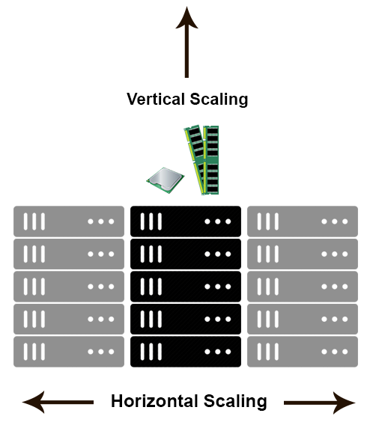

Sharding in MongoDB

Slide 53
Sharding in MongoDB
Sharded Cluster:
Components –
Shard: is a sub-set of data and each shard is a replica set. One sharded cluster can contain multiple shards.
Router(mongos): is a query router for sharded cluster.
Config servers: stores the metadata about shards and configuration settings along with the mongos configuration.
It also contains keys (known as shard key) which must be present in all shards to identify a particular shard. This key contains a range.

Slide 54
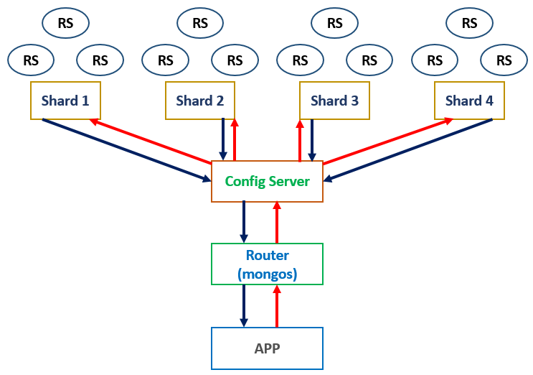
Sharding in MongoDB
Sharding Architecture:

Slide 55
Files

Slide 56
Thank You

